Slide 1

Rodrigo Rocha, 71731
Rodrigo Relvas, 71860
João Pedro, 80098
Fábio Nunes, 80139
Diana Silva, 80239
Susana Dias, 80410
PEI 2018-2019
Mestrado Integrado em Engenharia de Computadores e Telemática
Notes:
PRESENT THE GROUP:
RODRIGO, RODRIGO, FÁBIO, JOÃO, DIANA, SUSANA
MENTION MENTORS: keeping up with our work and helping PEDRO COSTA
CTO LÚCIA BILRO
CEO ROGÉRIO NOGUEIRA

Slide 2
Monitoring the winemaking process is quite time/resource consuming;
Real time data of:
Density;
Temperature;
Color;
Turbidity;
Level;
Notes:
MONITORING WINEMAKING TAKES A LOT OF TIME AND RESOURCES
WINEGRID CAME UP WITH A SENSOR THAT CAN GIVE US REAL TIME DATA OF …
SENSORS IMPLEMENTED IN WINE CELLARS
SEND DATA TO THE WEB APP
THIS IS WHERE WE ENTER

Slide 3
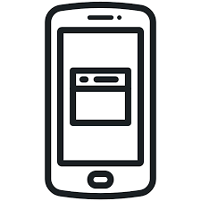

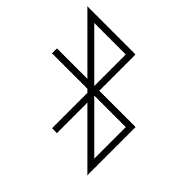
Our challenge
Mobile app
Data analysis
Bluetooth Low Energy server
Notes:
OUR CHALLENGE IS:
DEVELOP MOBILE APP TO CONNECT SENSOR VIA BLE
PAIRING THROUGH BAR CODE OR QR CODE
DATA ANALYSIS OF GRAPHICS CREATED WITH THE DATA COLLECTED

Slide 4
1st Demo
Mobile app
Bluetooth Low Energy server
Login
Open note
Delete note
Show note
Create note
List notes
Check notes on dashboard (web app)
Open serial COM to communicate with DevBoard (ESP32);
Dev Board reset (ESP32);
Open app;
Scan Barcode and QR code;
Dev Board connect;
Verify app and serial COM communication status;
Verify received data from Dev Board;
Notes:
WORKED HARD AND ALMOST ACHIEVED FULL MVP
WE ARE GOING TO SHOW OUR MOBILE APP USING THE API TO TALK TO THE WEB APP AND MESS WITH SOME NOTES
CONNECT TO A SENSOR VIA QR CODE AND BARCODE AND SIMULATE SENSOR VALUES DOING READINGS AND SHOWING THEM IN OUR APP

Slide 5
Please Murphy be good to us!
https://drive.google.com/open?id=15QC1cyvMGtL9cFBHO16wBwfiUiRG1xHZ
https://drive.google.com/open?id=12QwdGgOWLTUkWM1crpgN-qDbyWmKJBeh
Notes:
IN CASE MURPHY FAILS US

